Slide 1
JavaScript

Slide 2

Brendan Eich
The first ever JavaScript was created by Brendan Eich at Netscape
Notes:
Netscape Communications Corporation was an American independent computer services company with headquarters in Mountain View, California and then Dulles, Virginia

Slide 3
Scripts?
something written : the written text of a stage play, screenplay, or broadcast specifically : the one used in production or performance.

Slide 4
Is “Java” + “Script” = Js
NO!!!, There's often some confusion about the two, but JavaScript and Java have almost nothing in common.
The name JavaScript came from Netscape's support of Java applets within its browser. Many say it was also a marketing tactic to divert some attention from Java, which was the most buzzed-about language at the time.

Slide 5
JavaScript
A lightweight programming language ("scripting language")

Slide 6
Java Script
JavaScript, often abbreviated JS, is a client-side scripting / programming language that is one of the core technologies of the World Wide Web, alongside HTML and CSS.
JavaScript is the fastest growing technology in the world.
Over 97% of websites use JavaScript on the client side for web page behavior, often incorporating third-party libraries.
JavaScript is a high-level, often just-in-time compiled language or can say interpreted.
It is a web standard (but not supported identically by all browsers)
Organization ECMA defines standards and offers the Specification and JS follows that thus ECMAScript is the official name of the JavaScript language

Slide 7
How does JavaScript Code run?

Slide 8
Parse JavaScript using Runtime Environment
In 2009 Ryan Dahl took the open-source engine of chrome and embedded it into C++ to create NODE.
Spider Monkey By Mozilla Firefox
V8 Engine in the Google Chrome
JavaScript Engine
Different Engines
Web Browsers
Embedded V8
NODE for Operating Systems
C++ Code

Slide 9
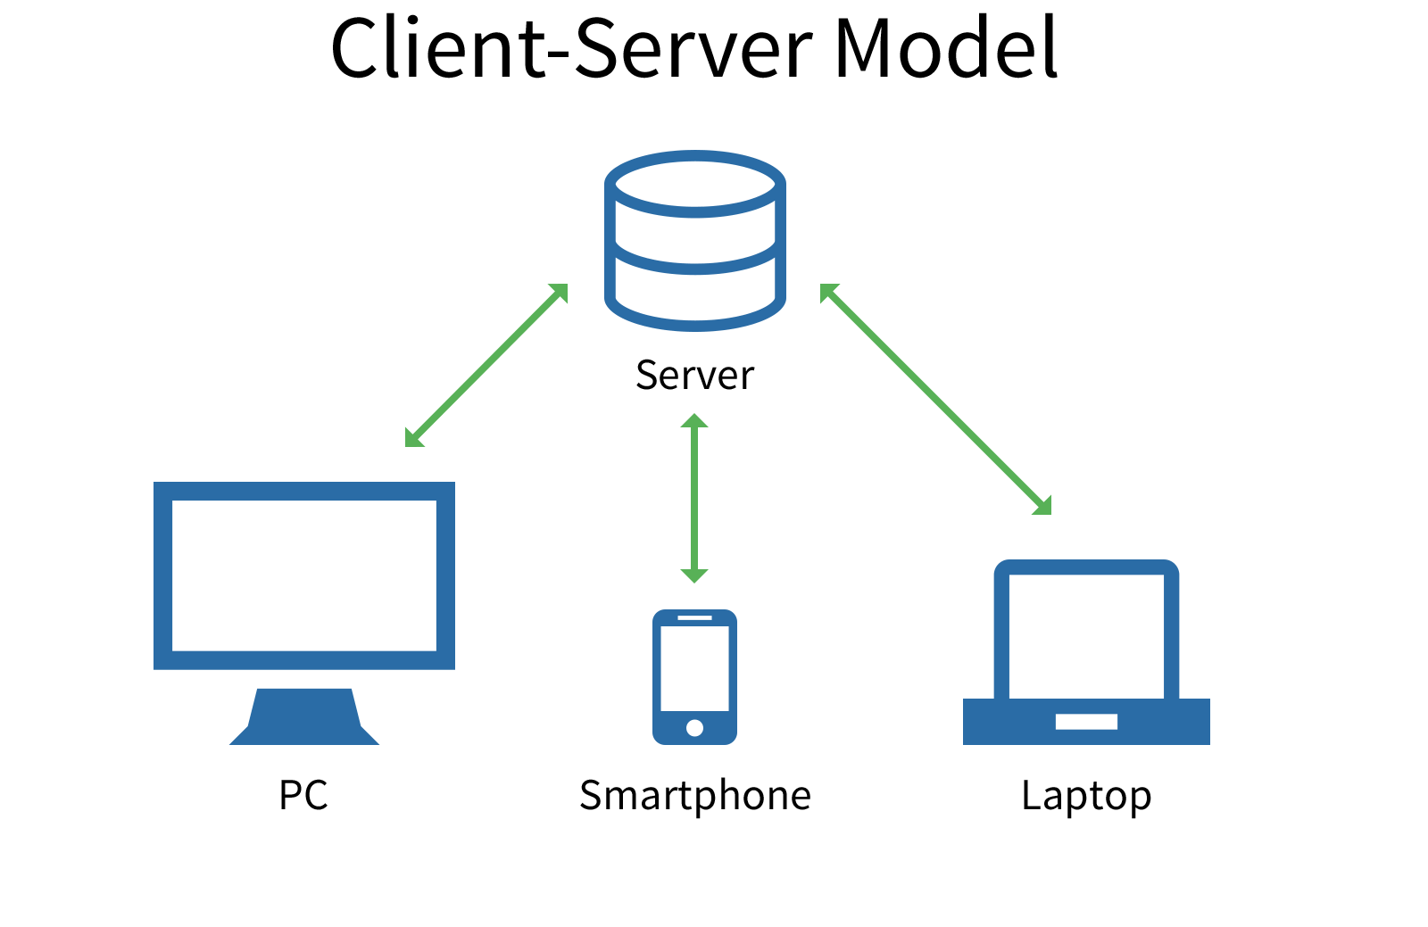
Backend
Frontend

Slide 10
Why use client-side programming?
Usability:
Efficiency:
Event-driven:
Can modify a page without having to post back to the server (faster UI)
Can make small, quick changes to page without waiting for server
Can respond to user actions like clicks and key presses

Slide 11
HTML, CSS & JS
Backbone of any web design
HTML is all about content & flow
CSS is all about layouts & presentation
JavaScript is all about behaviour & functionality

Slide 12
JavaScript Example

Slide 13
<!DOCTYPE html>
<html>
<body>
<h2>Example</h2>
<p id=“example">Join Us</p>
<button type="button" onclick='document.getElementById(“example").innerHTML = “Welcome to Careerera"'>Click Me!</button>
<script>
document.getElementById("example").innerHTML = “Yes Sure!";
</script>
</body>
</html>

Slide 14
JavaScript offers
Variables
Conditions
Operations
Loops
Logics
Functions
Classes

Slide 15
ES6
Organization ECMA defines standards and offers the Specification and JS follows that thus ECMAScript is the official name of the JavaScript language
Arrow functions were introduced in ES6.

Slide 16
Frameworks

Slide 17


Slide 18

Next.js is an open-source web development framework built on top of Node.js enabling React based web applications functionalities such as server-side rendering and generating static websites.

Slide 19

What is TypeScript
TypeScript is a JavaScript "Syntactic Superset" with strongly typed code, developed and maintained by Microsoft offering the same base syntax as JavaScript but with added benefits.

Slide 20
Transpilers
Transpilers (also called transcompilers) in JavaScript are source-to-source compilers that transform source code in non-JavaScript languages (CoffeeScript, TypeScript, LiveScript, etc.)

Slide 21
Hands On

Slide 22
Quick Program
<!DOCTYPE html>
<head>
<title>Demo #1</title>
</head>
<body>
<h1 id="test">Hi</h1>
<script>
console.log("Hi");
alert("Hello");
document.getElementById("test").innerHTML = "hello";
</script>
</body>
</html>

Slide 23
IDE & Console
VS Code and Chrome’s Console
Notes:
Clear the console by pressing ctrl + L

Slide 24
Internal
<script> and </script>
In Header or in footer
External
<script src=“anyname.js” type="text/javascript"></script>

Slide 25
Where to put JavaScript
Placing scripts at the bottom of the <body> element improves the display speed, because script interpretation slows down the display.

Slide 26
Placement of JavaScript
Two most common reasons are that a page loads in a linear manner from top to bottom so if java script is on the top browser will search for it and will increase the time without even displaying any element resulting in bad user experience.
Second important reason is that most of the time JavaScript interacts with the DOM Components and thus placing it at bottom allows all the components to render first and then JavaScript can apply all the operations like show/hide or popup or validate and so.
Exceptions are always there from third party like Google Analytics or so.
So, Putting the scripts at the end of your html’s body can help browser can parse it at the end to enhance user experience

Slide 27
Comment
Single line comments start with //
Multi-line comments start with /* and end with */
In Tag comments start with <!-- and end with //-->
Example
<script>
<!--
document.write("Hello World!")
//-->
</script>
<noscript>Sorry, your browser does not support JavaScript!</noscript>

Slide 28
Dialog box
<script>
alert(“Hello I am alert”); - Just to display
confirm(“Are you sure”); - Returns True or False
prompt(“What is your Name?”); - Returns Null or User Input String
prompt(“Who are you?”, “Jack”);
</script>
Alert is a JS command that pops up a dialog box with a message

Slide 29
Output Display
document.getElementById("demo").innerHTML
HTML element, using .innerhtml.
Html output using document.Write().
Alert box, using window.Alert().
Browser console, using console.Log().

Slide 30
Variables
Variables are containers for storing data so should be meaningful not like a = x or a22 = y or so.
keywords Using var, let, const and nothing (undeclared ) to declare variables.
Let can change or can be reasign but const can’t as it is constant
All JavaScript identifiers (name of unique variable) are case sensitive
Hyphens are not allowed in JavaScript
Underscore, Upper Camel Case (Pascal Case) and Lower Camel Case allowed
A JavaScript name must begin with:
A letter (A-Z or a-z) not with a number
A dollar sign ($)
Or an underscore (_) but can't contain space
#IMPORTANT – In jQuery (JavaScript library) $("p"); means "select all p elements
Notes:
variables don't need to be declared

Slide 31
Variables Declaration
variables are declared with the var keyword (case sensitive)
types are not specified, but JS does have types ("loosely typed")
Number, Boolean, String, Array, Object, Function, Null, Undefined
can find out a variable's type by calling typeof
var name = expression;
var clientName = “The Client";
var age = 41;
var weight = 127.4;
Notes:
To check the type of variable use command below
let nameofVariable = “Careerera”;
Typeof nameofVariable
Output will be string
Try again
nameofVariable = 1
Typeof nameofVariable
Output will be number

Slide 32
var clientName = “The Client";
alert(clientName);

Slide 33
Primitive or Value Type
Reference Type
String
Number
Boolean
Undefined
Null
integers and real numbers are the same type (no int vs. double)
Object
Array
Function

Slide 34
String type
methods: charAt, charCodeAt, fromCharCode, indexOf, lastIndexOf, replace, split, substring, toLowerCase, toUpperCase
var s = "Connie Client";
var fName = s.substring(0, s.indexOf(" ")); // "Connie"
var len = s.length; // 13
var s2 = 'Melvin Merchant';
Notes:
methods: charAt, charCodeAt, fromCharCode, indexOf, lastIndexOf, replace, split, substring, toLowerCase, toUpperCase
charAt returns a one-letter String (there is no char type)
length property (not a method as in Java)
Strings can be specified with "" or ''
concatenation with + :
1 + 1 is 2, but "1" + 1 is "11“
charAt()
charCodeAt()
concat()
constructor
endsWith()
fromCharCode()
includes()
indexOf()
lastIndexOf()
length
localeCompare()
match()
prototype
repeat()
replace()
search()
slice()
split()
startsWith()
substr()
substring()
toLocaleLowerCase()
toLocaleUpperCase()
toLowerCase()
toString()
toUpperCase()
trim()
valueOf()

Slide 35
Converting between numbers and Strings:
var count = 10;
var s1 = "" + count; // "10"
var s2 = count + " bananas, ah ah ah!"; // "10 bananas, ah ah ah!"
var n1 = parseInt("42 is the answer"); // 42
var n2 = parseFloat("booyah"); // NaN

Slide 36
accessing the letters of a String:
var firstLetter = s[0]; // fails in IE
var firstLetter = s.charAt(0); // does work in IE
var lastLetter = s.charAt(s.length - 1);

Slide 37
Splitting strings: split and join
split breaks apart a string into an array using a delimiter. It can also be used with regular expressions (seen later).
join merges an array into a single string, placing a delimiter between them
var s = "the quick brown fox";
var a = s.split(" "); // ["the", "quick", "brown", "fox"]
a.reverse(); // ["fox", "brown", "quick", "the"]
s = a.join("!"); // "fox!brown!quick!the"

Slide 38
Special values: null and undefined
undefined : has not been declared, does not exist
null : exists, but was specifically assigned an empty or null value

Slide 39
Operators
operators: + - * / % ++ -- = += -= *= /= %=
arithmetic operators ( + - * / ) to compute values
assignment operator ( = ) to assign values to variables
Equal to operator (==) to compare values of variables
Equal to operator (===) to compare strict values of variables
Notes:
many operators auto-convert types: "2" * 3 is 6

Slide 40
Logical operators
> < >= <= && || ! == != === !==
most logical operators automatically convert types:
5 < "7" is true
42 == 42.0 is true
"5.0" == 5 is true
=== and !== are strict equality tests; checks both type and value
"5.0" === 5 is false

Slide 41
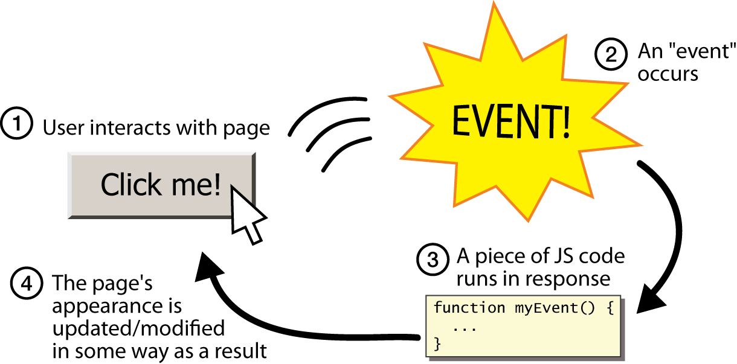
Events
JavaScript programs wait for user actions called events and respond to them
event-driven programming: writing programs driven by user events

Slide 42
Event handlers
JavaScript functions can be set as event handlers
when you interact with the element, the function will execute
onclick is just one of many event HTML attributes we'll use
but popping up an alert window is disruptive and annoying
A better user experience would be to have the message appear on the page...

Slide 43
onClick Event
<input type=button onClick=myMessage() Value=Click >
<script/>
function myMessage()
{
alert("Hello!");
document.write("<strong>Hello World</strong>");
}
</script>

Slide 44
JavaScript functions
function name() {
statement ;
statement ;
...
statement ;
}
function myFunction() {
alert("Hello!");
alert("How are you?");
}

Slide 45
Functions
function function_Name(parameters) { // your code here
//action, display or return }
<p id=“ex”></p>
<script> function functionName() { document.getElementById(“ex").innerHTML = “Updated Text"; } </script>
<button type="button" onclick="myFunction()">Try it</button>

Slide 46
DOM
Document Object Model

Slide 47
Example DOM
<script> var clientName = "The Client"; alert(clientName); document.write('<p id="myId">Your Name will appear here</p>'); var clientName = prompt("What is your Name?"); alert("Hello " + clientName); document.getElementById("myId").innerHTML = "Hello " + clientName; </script>

Slide 48
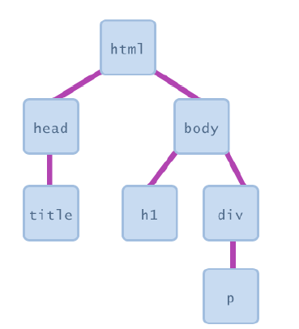
most JS code manipulates elements on an HTML page
we can examine elements' state
e.g. see whether a box is checked
we can change state
e.g. insert some new text into a div
we can change styles
e.g. make a paragraph red

Slide 49
DOM element objects
<img src= "buddy.jpg" alt= "buddy pic" id= "unique_buddy" title = "buddy" />
<script>
var bropic = document.getElementById("unique_buddy");
bropic.alt = "New buddy pic";
bropic.src = "newbuddy.jpg";
bropic.title = "New buddy pic";
</script>
Property | Value
tagname | “img”
src | "buddy.jpg"
alt | "buddy pic"
title | "buddy"
id | "unique_buddy"

Slide 50
Accessing elements: document.getElementById
document.getElementById returns the DOM object for an element with a given id
can change the text inside most elements by setting the innerHTML property
can change the text in form controls by setting the value property like
.innerHTML
.style

Slide 51
Changing element style: element.style
Attribute | Property or style object
color | color
padding | padding
background-color | backgroundColor
border-top-width | borderTopWidth
Font size | fontSize
Font famiy | fontFamily

Slide 52
Example: DOM Element Style
<button onclick="changeText();">Click me!</button>
<span id="output">replace me</span>
<input id="textbox" type="text" />
<script>
function changeText() {
var color = prompt("type any color");
var textBox = document.getElementById("textbox");
textbox.style.color = color;
textbox.style.fontSize = "16pt";
}
</script>

Slide 53
Array
var name = []; // empty array
var name = [value, value, ..., value]; // pre-filled
name[index] = value; // store element
var ducks = ["Huey", "Dewey", "Louie"];
var stooges = []; // stooges.length is 0
stooges[0] = "Larry"; // stooges.length is 1
stooges[1] = "Moe"; // stooges.length is 2
stooges[4] = "Curly"; // stooges.length is 5
stooges[4] = "Shemp"; // stooges.length is 5

Slide 54
Array methods
array serves as many data structures as possible: list, queue, stack, ...
var a = ["Stef", "Jason"]; // Stef, Jason
a.push("Brian"); // Stef, Jason, Brian
a.unshift("Kelly"); // Kelly, Stef, Jason, Brian
a.pop(); // Kelly, Stef, Jason
a.shift(); // Stef, Jason
a.sort(); // Jason, Stef
Notes:
methods: concat, join, pop, push, reverse, shift, slice, sort, splice, toString, unshift
push and pop add / remove from back
unshift and shift add / remove from front
shift and pop return the element that is removed

Slide 55
if/else statement
JavaScript allows almost anything as a condition
if (condition) {
statements;
} else if (condition) {
statements;
} else {
statements;
}

Slide 56
for loop
var sum = 0;
for (var i = 0; i < 100; i++) {
sum = sum + i;
}
var s1 = "hello";
var s2 = "";
for (var i = 0; i < s.length; i++) {
s2 += s1.charAt(i) + s1.charAt(i);
}
// s2 stores "hheelllloo"

Slide 57
while loops
while (condition)
{
statements;
}
do
{
statements;
}
while (condition);

Slide 58
Math object
methods: abs, ceil, cos, floor, log, max, min, pow, random, round, sin, sqrt, tan
properties: E, PI

Slide 59
Thanks
In case of any assistance,
please feel free to contact us at
info@careerera.com

